Slide 1
CiviCRM Entity
Superior Drupal Integration for CiviCRM with a focus on Events

Slide 2
Nothing in this presentation requires coding
CiviCRM Entity is a Tool for site builders / DIYs.
Build fantastic displays in hours.

Slide 3
Advantages of Entities
Seamless Integration with Drupal Core and Contrib
Works with 100s of Drupal modules such as Rules, Entity Reference, Search API, Entity Views Attachments, Panels
Drupal Fields
Configurable Drupal View Page, Edit and Add forms
Drupal “thinks” CiviCRM data is Drupal data

Slide 4
40+ Entities
Contacts, Memberships, Groups, Tags, Relationships, Activities
Events and Contribution Pages
Address, Phone, Email, Website, IM
Contributions, Recur, LineItem, FinancialTxrn, MembershipPayment, etc..
UFField, UFJoin, UFGroup, UFMatch
Price sets, Price field, Price field value

Slide 5
Drupal Rules
Easy to configure custom workflows
Respond to events
Under certain conditions
Execute actions
Many of each out of the box, many add-on modules
Not difficult to add custom events, conditions, or actions
Export / Import between sites

Slide 6
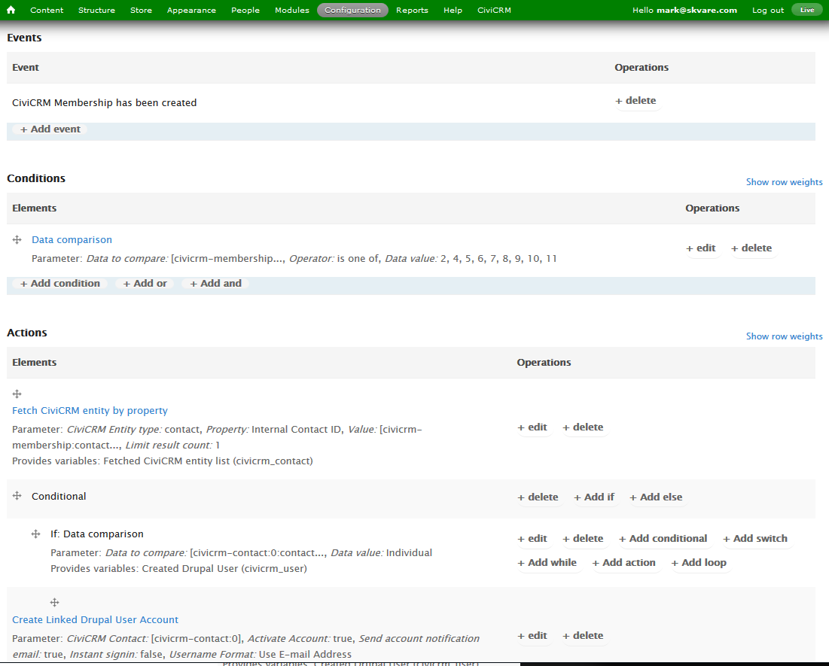
Drupal Rules

Slide 7
Use Drupal for Presentation
Drupal built to manage multimedia
Configurable Displays
Use 100s of Responsive Themes
Standard interface to rest of website
Slideshows, Videos, Maps, Comments, etc...

Slide 8
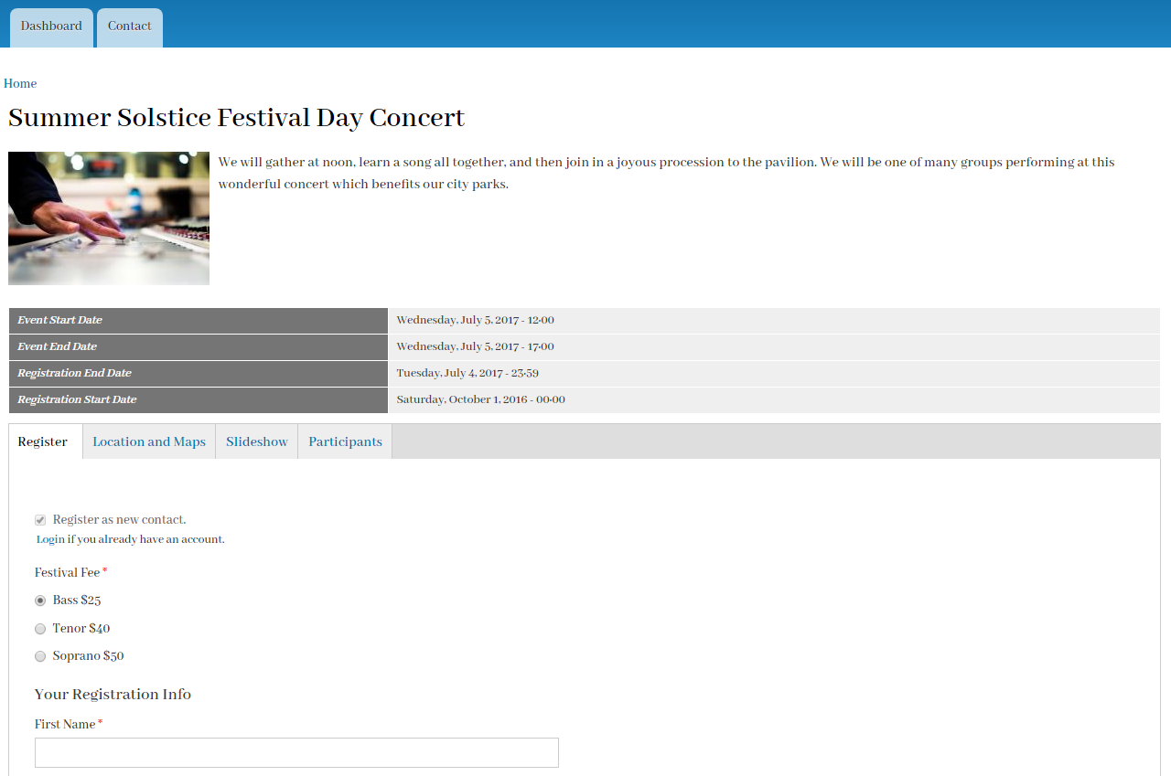
Configurable Display

Slide 9
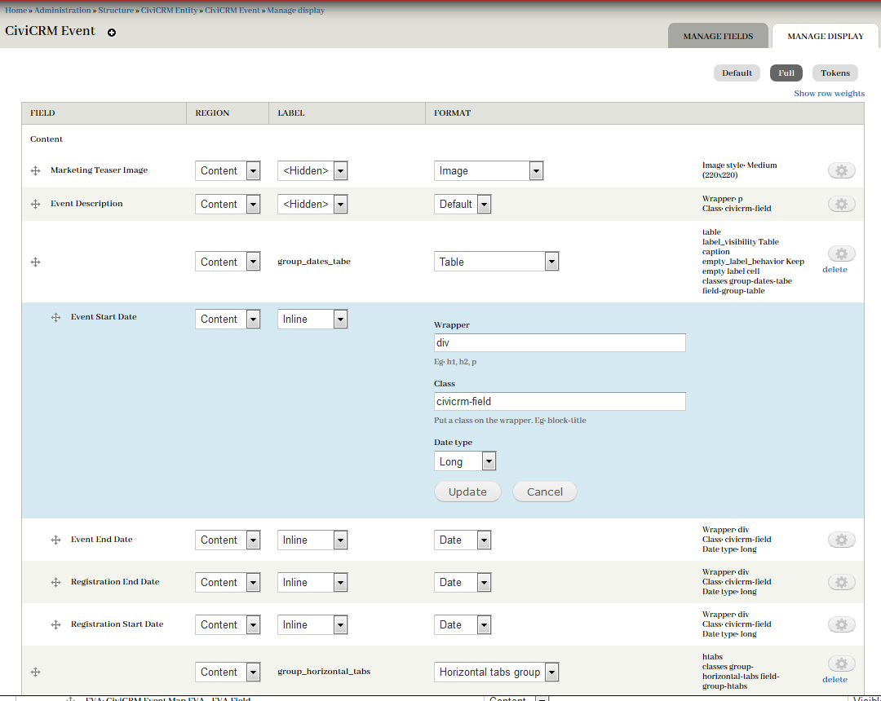
Configurable Display

Slide 10
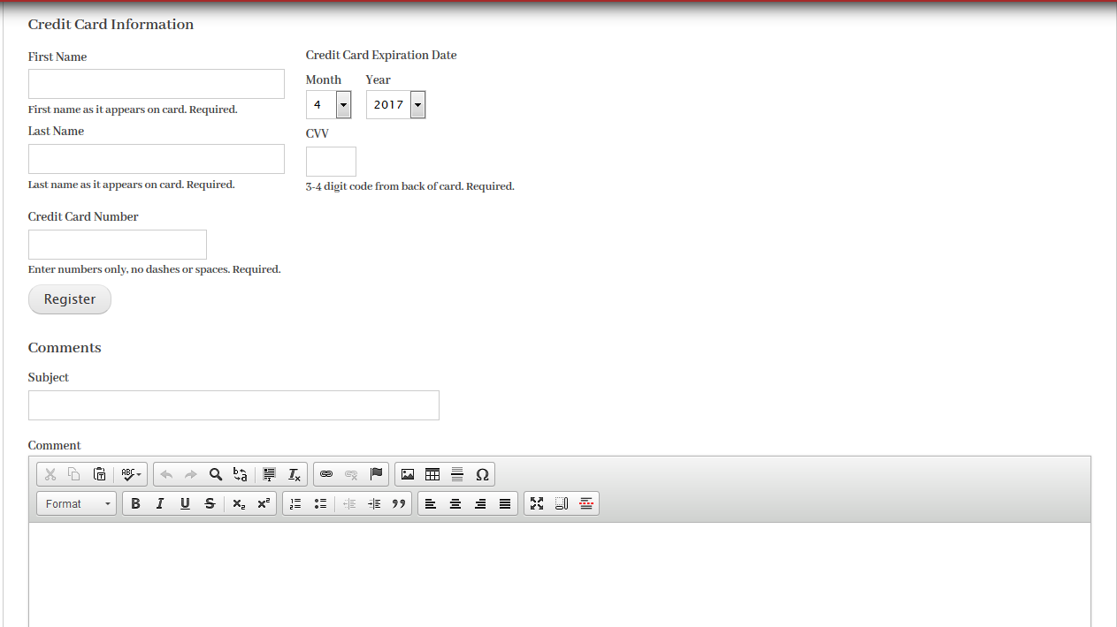
Integrate other features

Slide 11
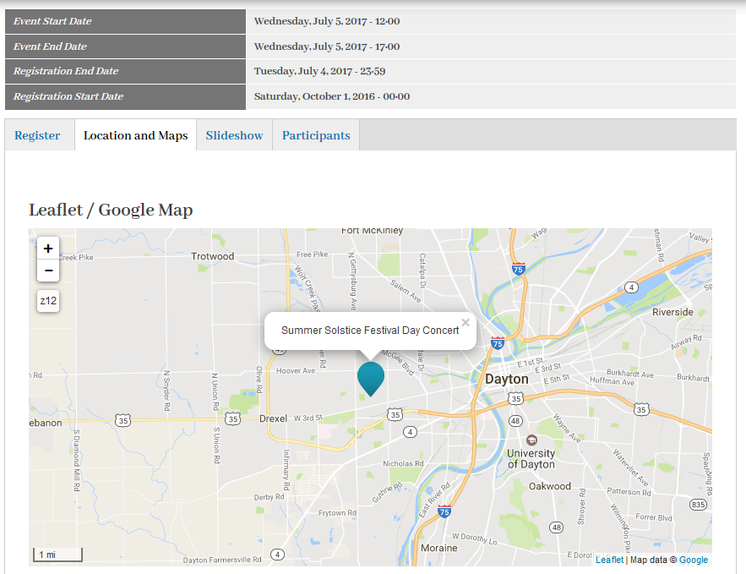
Integrate other features

Slide 12
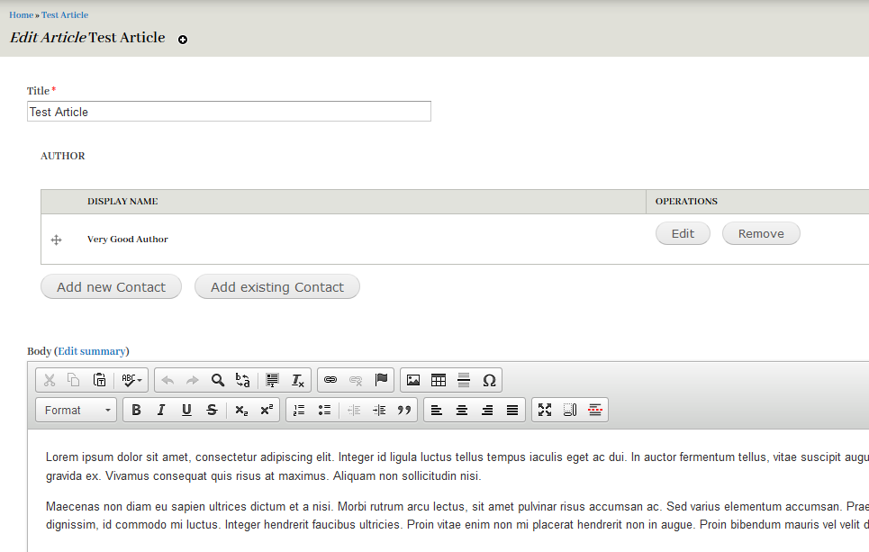
Inline Entity Reference Forms

Slide 13
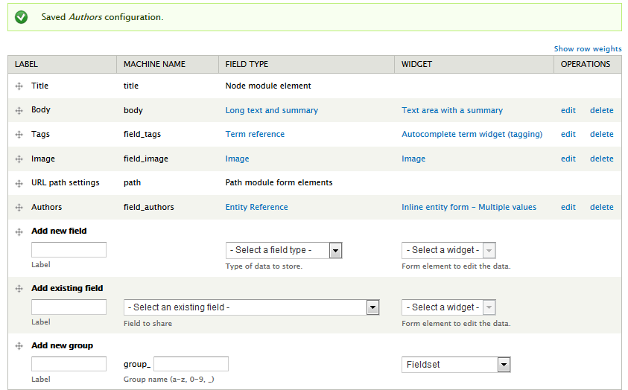
Inline Entity Reference Forms

Slide 14
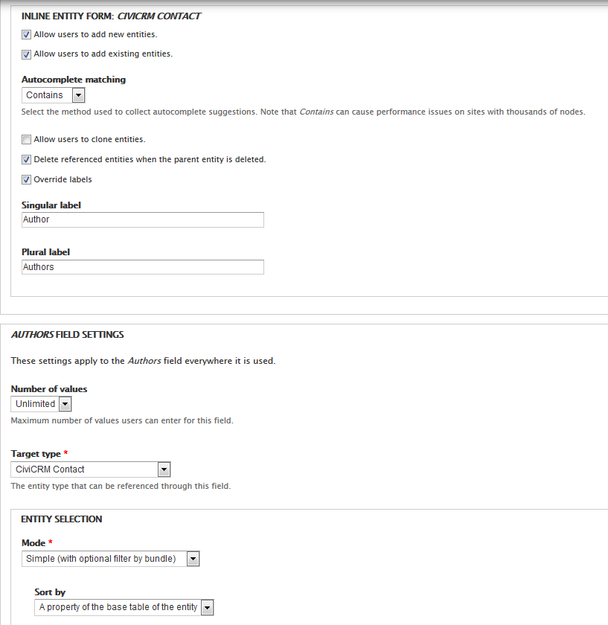
Inline Entity Reference Forms
Modules Used:
Entity Reference
Inline Entity Form
Great way for non-admin user to create contacts for a specific purpose

Slide 15
Drupal Edit forms
Add/edit form for each entity
/[civicrm-entity-type]/[id]/edit, e.g /civicrm-event/3/edit
Give limited access without giving access to CiviCRM backend
Combine CiviCRM and Drupal fields
Configurable forms, for more features use the Display Suite Forms module
Hide unnecessary fields
Layouts and Field groups

Slide 16
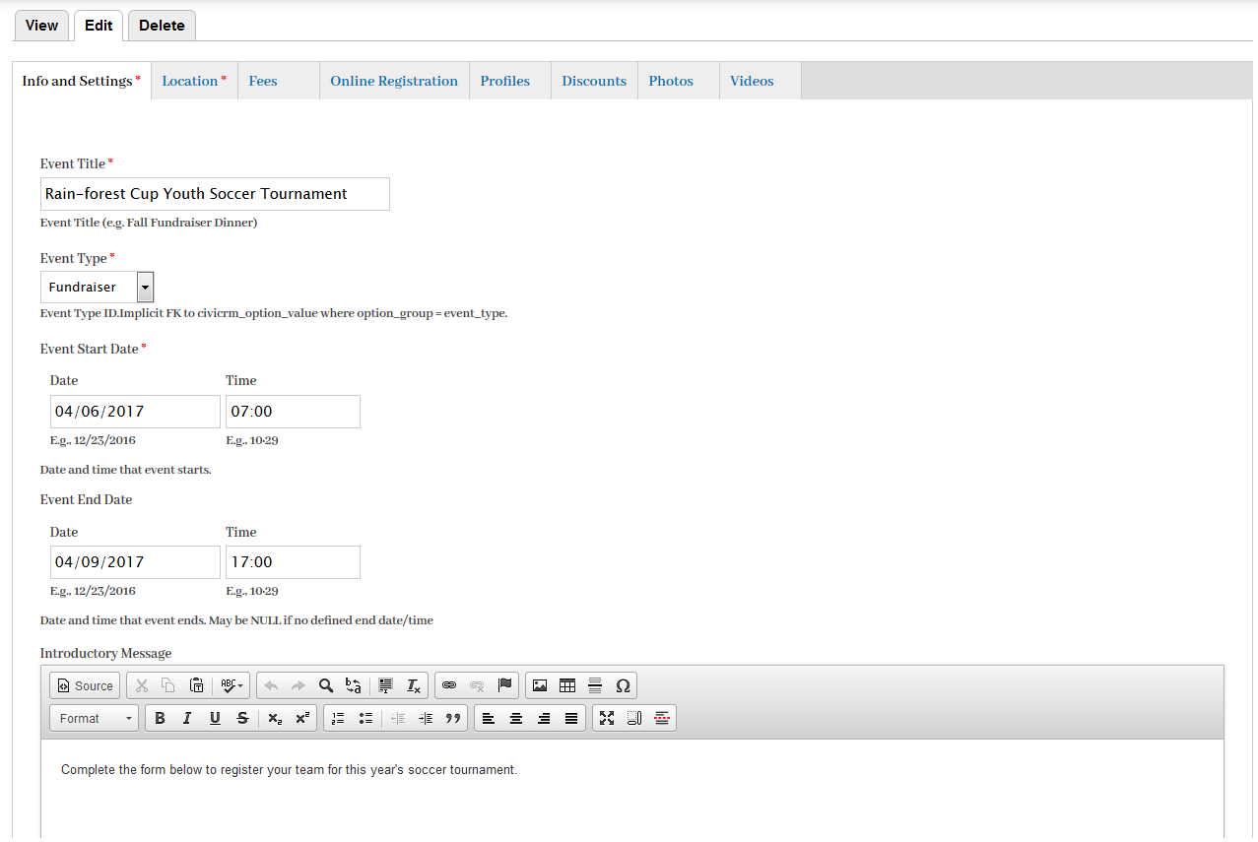
Event Edit Form

Slide 17
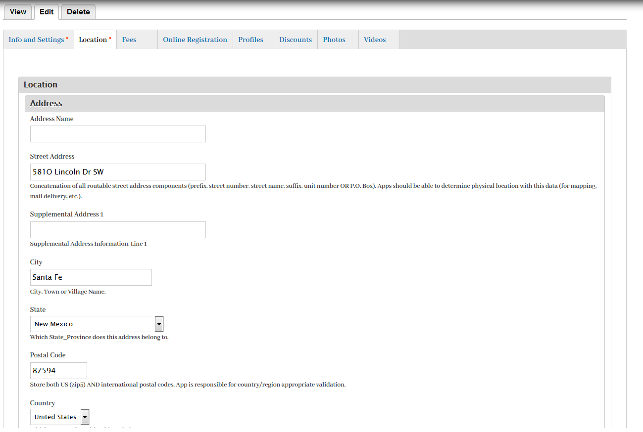
Editing the CiviCRM Location Block and Address entities directly
Event Edit From - Location

Slide 18
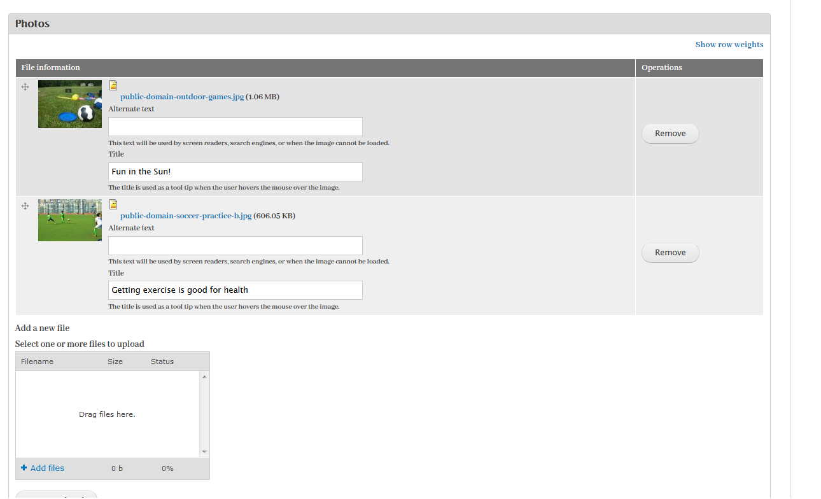
Event edit Form

Slide 19
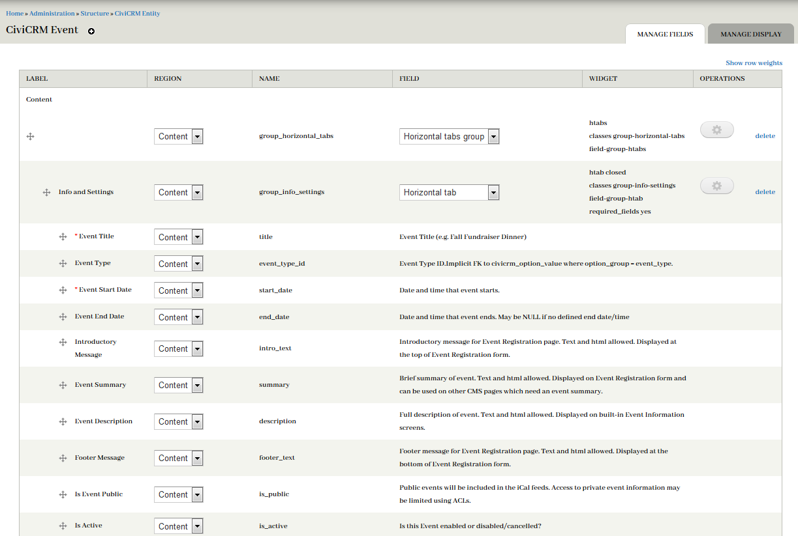
Event Edit Form Configuration

Slide 20
Drupal Fields are a Design Model
Powerful, Field API
100s of field types available from existing contrib modules
We create custom interfaces for our customers
CiviCRM Entities sub modules
Create your own

Slide 21
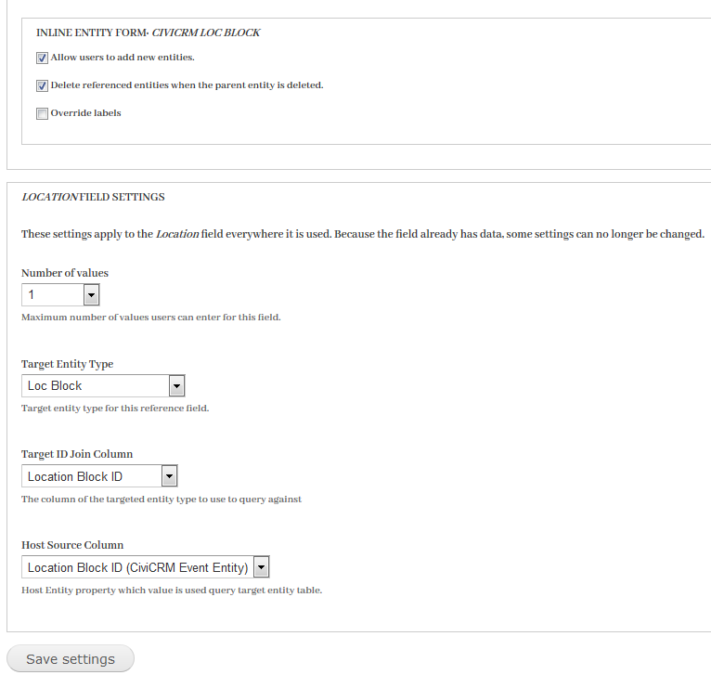
CiviCRM Entity Reference Field
Remote Reference Field
Standard Drupal field widgets
Accesses and stores data from CiviCRM tables
Works like a regular Entity Reference field

Slide 22
CiviCRM Group Assign
Good example of custom interfaces that can be created for CiviCRM data in Drupal with fields
Configurable Widget
Learn to develop one, easy to build 50

Slide 23
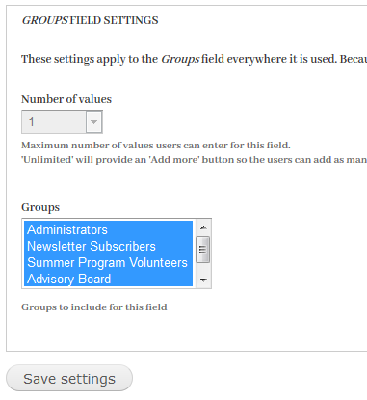
Group Assign Field Config

Slide 24
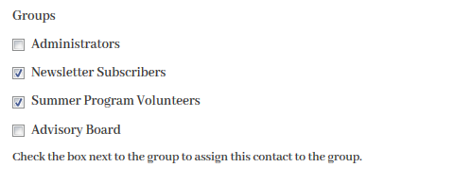
Group Assign Field Config
Edit Widget, Checkboxes

Slide 25
CiviCRM Price Set Field
Provide Registration Form for Drupal Event pages
Renders all price fields for the event’s price set
Profiles, logged in user default values
Multiple participants
Credit Card or Pay later
Ajax Confirmation and Thank you panes, no page reload
Respects event configuration

Slide 26
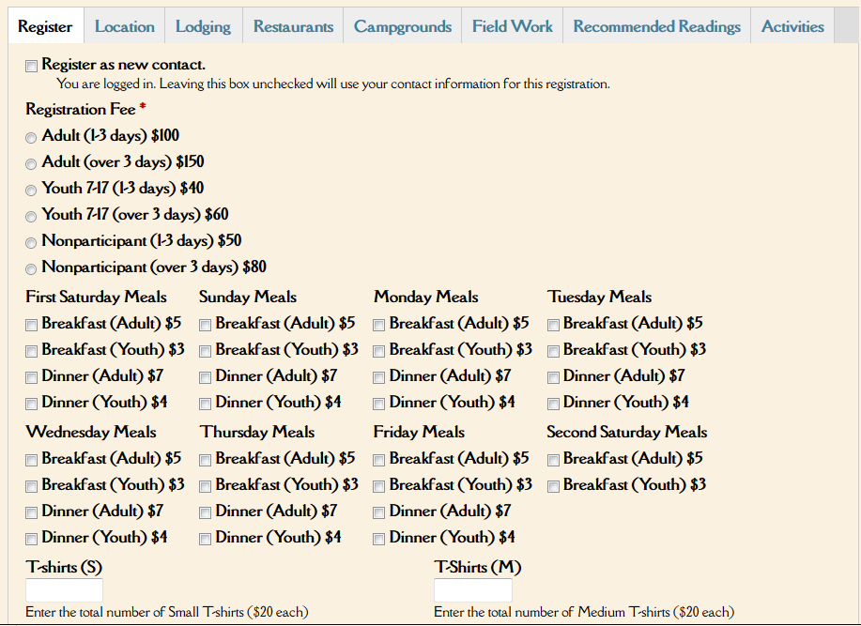
Price Set Field -- Price Fields

Slide 27
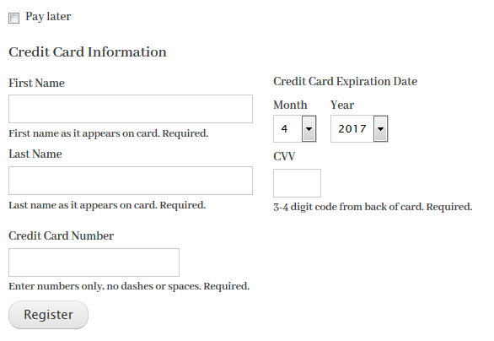
Price Set Field -- CC or pay later
Tested in Production with iATS and Authorize.net
Will work with any Payment Processor that can be used with ‘transact’ Contribution API
Developers -- hooks to alter or integrate other / custom payment processors

Slide 28
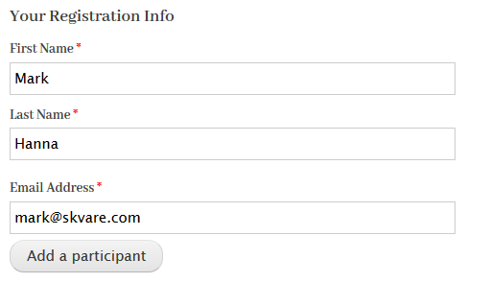
CiviCRM Entity Profile
Use the event’s configured profiles on the registration form

Slide 29
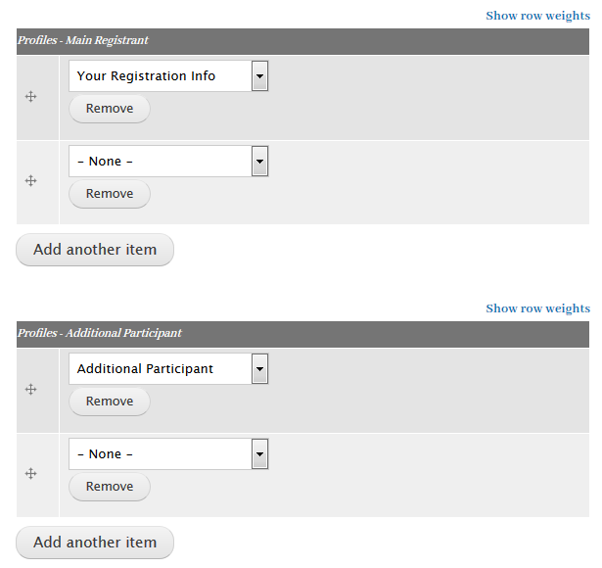
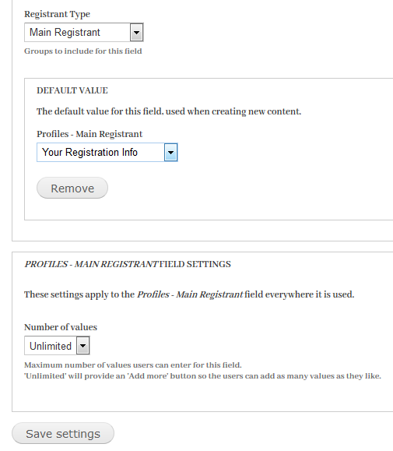
CiviCRM Entity Profile

Slide 30
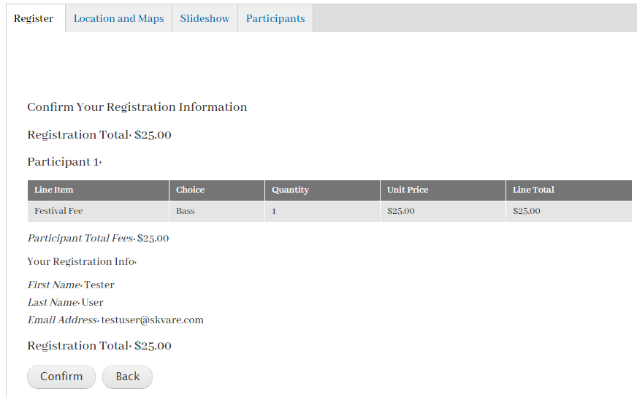
Confirmation and Thank You panes

Slide 31
Same financials as the stock form
Line item for each price set value for each price field, for each participant
ParticipantPayment record

Slide 32
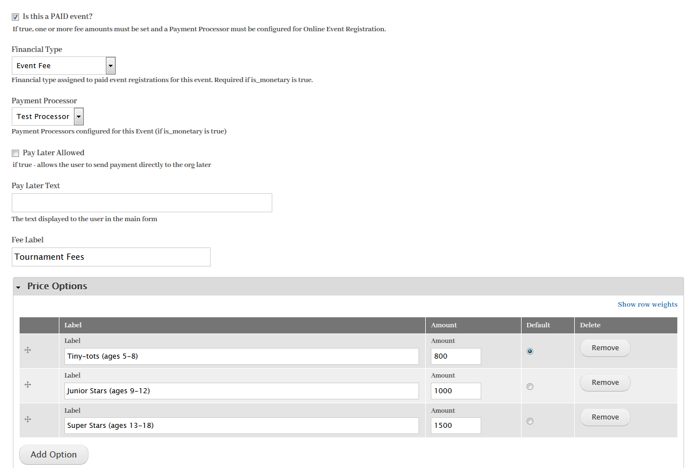
Respects Event Configuration

Slide 33
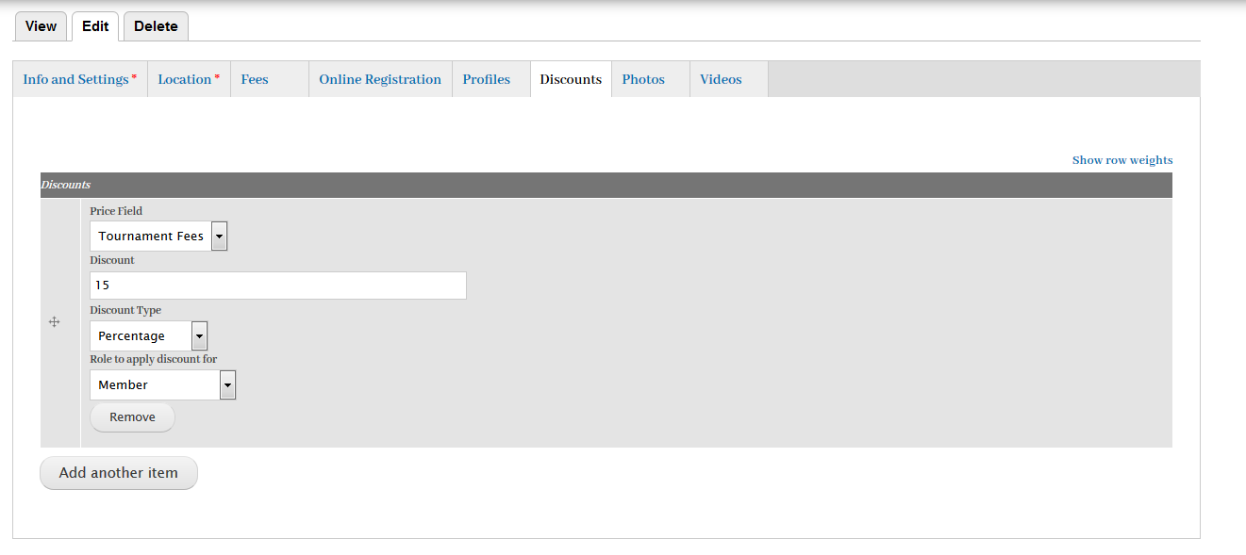
CiviCRM Entity Discount
Add per price field, per role discounts

Slide 34
Download
https://www.drupal.org/project/civicrm_entity

Slide 35
About me
https://skvare.com/contact
Mark Hanna, Senior Developer, CiviCRM Entity Module maintainer
@jackrabbithanna on CiviCRM Mattermost chat and SE
Find me in the CiviCRM Entity channel
markusa on Drupal.org

Slide 36
Discussion Topics
All entities can be used in a similar fashion
Drupal 8
Developers
Price set field for Contribution Pages

